Slide 1
Professional Development Program Data Collection System (PDPDCS)
OFFICE of INDIAN EDUCATION (OIE),
Office of Elementary and Secondary Education (OESE)
Angela Hernandez-marshall, Oie
Karen schroll, Westat
Amanda pierce, westat
February 6, 2020

Slide 2
Training Agenda
OIE Welcome and Training Purpose
Review required actions for data submission
Protecting Participant Data
Address frequently asked questions about the PDPDCS
Understand the resources available to you and your participants
Notes:
Please type your questions directly into the chat box. Thank you!

Slide 3
OIE Welcome
Angela Hernandez-Marshall
Office of Indian Education
Notes:
Welcome all!
ANGELA, PLEASE INSERT UPDATE.

Slide 4
PDPDCS Purposes
Comply with regulatory requirement to track Participant training and payback information
(34 CFR 263.11)
Supplement annual performance report (APR) data, which will inform determination of your substantial progress continuation award decisions.
Repository for data used by the federal government to report overall performance of the Professional Development program
Notes:
ANGELA
Good morning everyone and thank you for joining us today. I want to take a moment to revisit the purposes of the PDPDCS, which you may recall us discussing during your fall project directors’ meeting last November.
First, you as the grantee are required to conduct a payback meeting with the participant to explain the costs of training and payback responsibilities following training, and obtain a signed payback agreement from each participant before the participant begins training.
Second, you have to report training costs for each Participant
Third you have to track the length of training for each participant
Finally, you’ll have to eventually report when a participant has exited the program with/or without program completion.
All of these data you will report in this collection system. Timely submission ensures:
You are achieving grant compliance
We have data to supplement the Annual Performance Report that you will be required to submit by April 14.

Slide 5

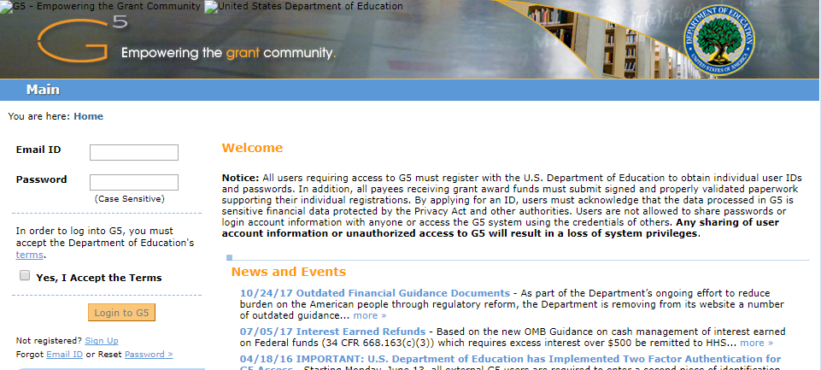
How is PDPDCS different from G5?
PDPDCS (https://pdp.ed.gov/oie)
ED Staff, grantees and Participants have access.
Where grantee submits participant training and payback information
Managed by OIE’s contracted staff (Anlar and Westat)
G5
(https://www.g5.gov)
ED Staff and grantees have access.
Where grantee can view grant funds draw-down activity
Where grantees will submit their APRs
Notes:
ANGELA
Good morning everyone and thank you for joining us today. I want to take a moment to revisit the purposes of the PDPDCS, which you may recall us discussing during your fall project directors’ meeting last November.
First, you as the grantee are required to conduct a payback meeting with the participant to explain the costs of training and payback responsibilities following training, and obtain a signed payback agreement from each participant before the participant begins training.
Second, you have to report training costs for each Participant
Third you have to track the length of training for each participant
Finally, you’ll have to eventually report when a participant has exited the program with/or without program completion.
All of these data you will report in this collection system. Timely submission ensures:
You are achieving grant compliance
We have data to supplement the Annual Performance Report that you will be required to submit by April 14 .

Slide 6
Actions to complete in the PDPDCS
Notes:
Transition to grantees’ to do list of all the activities they should be completing by the deadline of April 6th.

Slide 7

Activities to Complete in the PDPDCS
1
Log into the PDPDCS and review secondary user assignment
Add any new participants and upload Service Payback Agreements
Update funding amounts and service owed for participants still enrolled
Contact all participants with a status of “Awaiting Login” or “Fulfillment Not In Progress”
Review and submit all data by April 3rd deadline
2
3
5

Slide 8
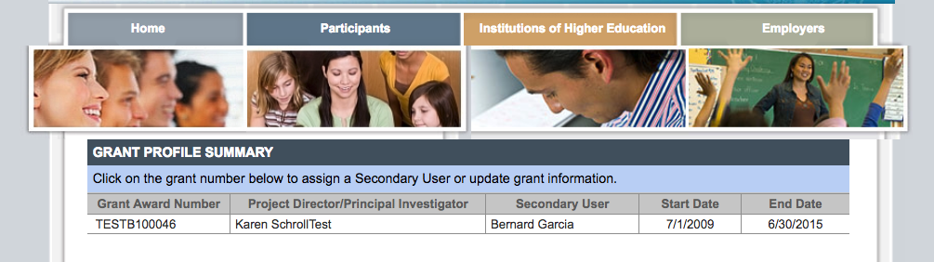
Step : Log into the PDPDCS
1
Log in and review the secondary users assigned to your grant.
Notes:
Set-up a secondary user if you want someone else with the grant to be able to enter participant information. However, the Project Director is held responsible for all data entries.
Each person should have a unique log in to the system. Do not share your password with anyone – add a secondary user! PDPDCS is governed by Federal security regulations; sharing your password violates those Federal security regulations.
Only two people per grant are permitted access.
Demo how to add or change a secondary user.

Slide 9
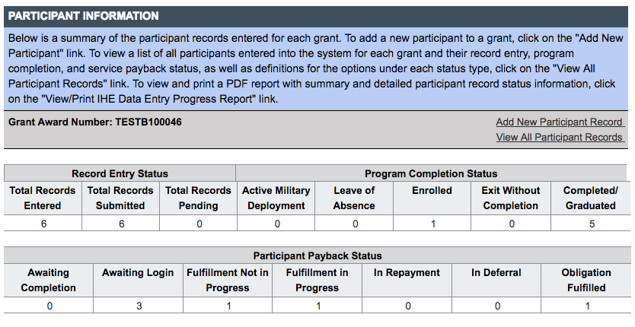
Step : Add new participants
2
Add records for new participants not already in the PDPDCS.
Notes:
You should add new participant records for participants not already in the system who have been enrolled in the program for 30 days or more. (Demo clicking on “Add New Participant Record” entering SSN and getting blank Participant Record to complete.)

Slide 10
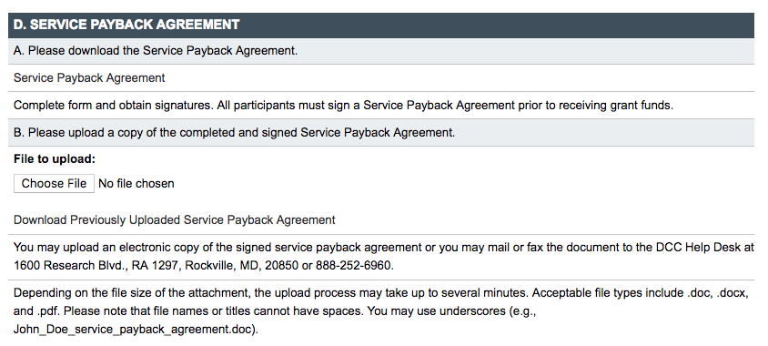
Step : Upload Service Payback Agreements
2
Notes:
Demo opening the record of a participant already entered.

Slide 11
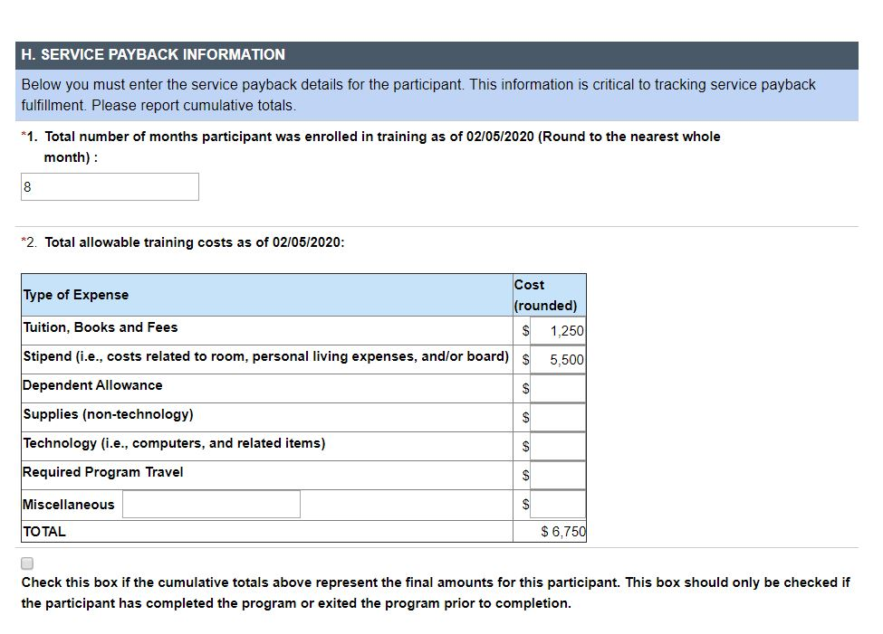
Step : Update Funding and Service Amounts
3
Notes:
Demo opening the record of a participant already entered.

Slide 12
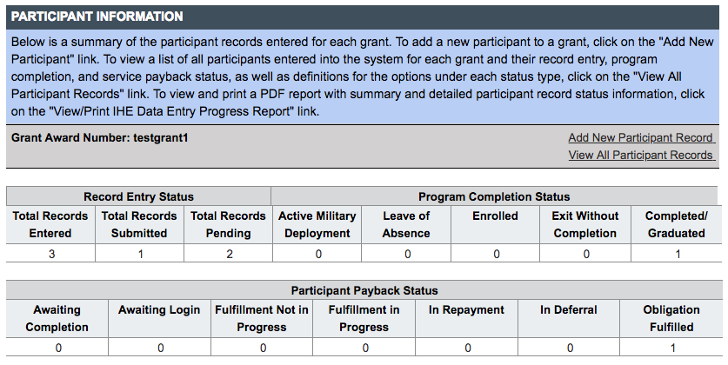
Step : Contact Participants “Awaiting Login” or “Fulfillment Not in Progress”
4
Notes:
Demo opening the record of a participant already entered.

Slide 13

Reminders for Participants
Participants are responsible for ensuring
their submitted employment gets
reviewed and verified by their employer.
Participants who do not have their
employment verified by the time their service payback must be fulfilled will be referred to ARBMD for cash payback.
Notes:
Participants employed in eligible positions should enter employment information so that there is complete and high-quality data to report for the performance measures and the participants can receive credit towards their service payback. Participants who do not submit eligible employment information that is verified by their employer by the time their service payback must be fulfilled are not in compliance and will be referred to ARBMD for repayment.

Slide 14
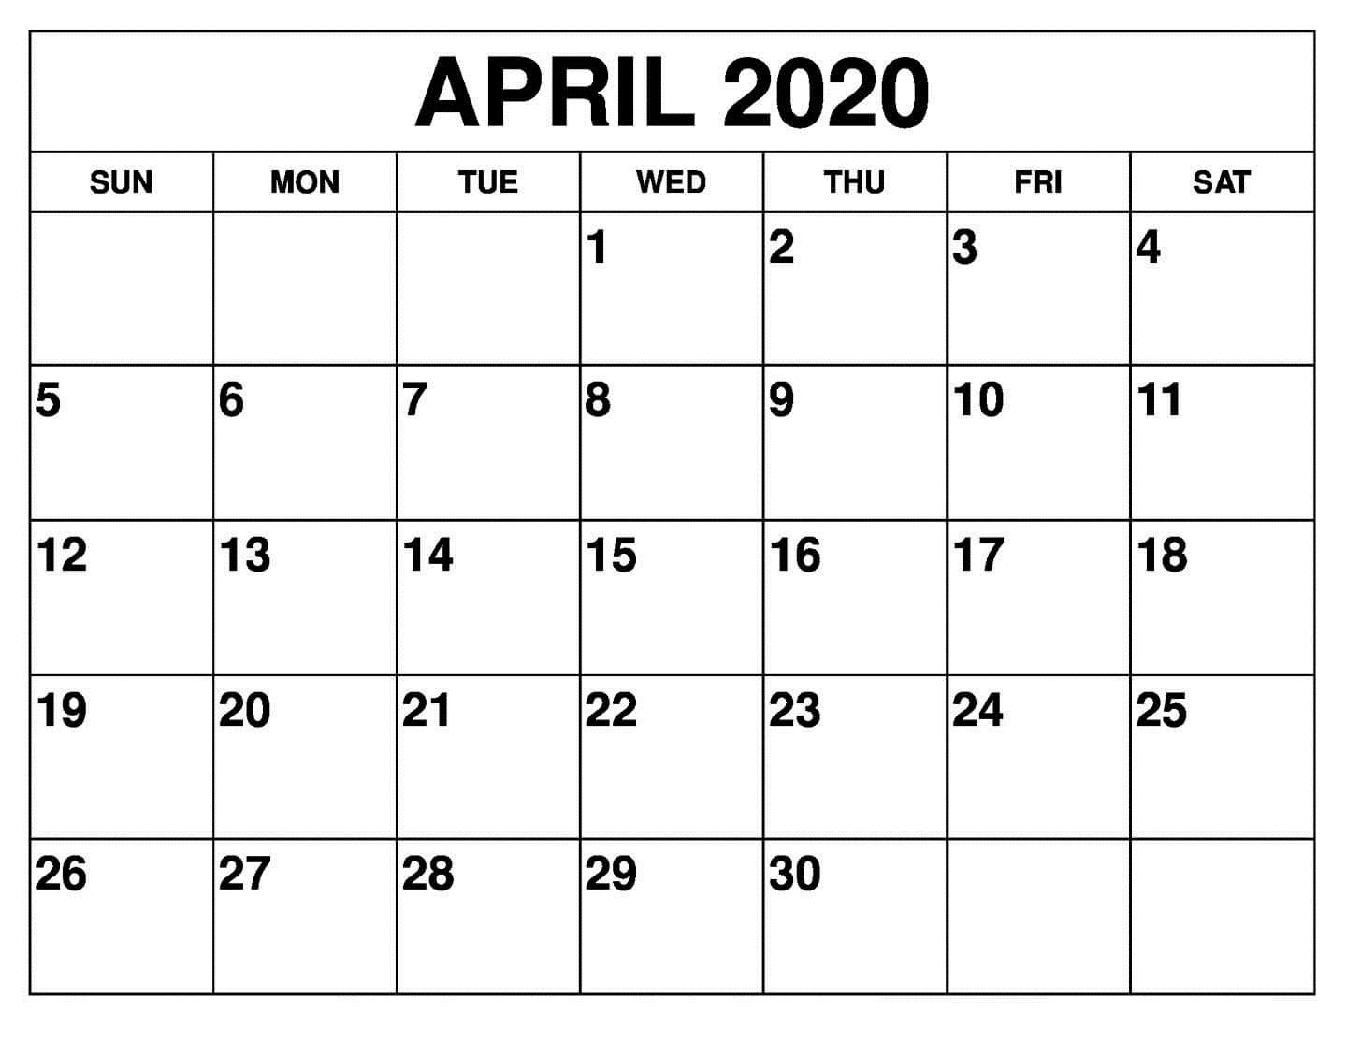
Step : Submit Data for ALL Participants by the Deadline
5
Notes:
Make sure by the deadline of April 3, 2020 you enter/update and submit records for all currently enrolled participants and participants who have graduated or exited prior to completion since your last update to the system. You do not need to update records for participants you have already submitted as graduated or exited prior to completion. In fact, once you have submitted a record for a participant with a status of graduated/completed or exited prior to completion you will not be able to edit the record. If you need to make any changes to these records please contact the Help Desk.
Make sure you have no participants in a pending status by the deadline. Participants cannot be left in a pending status for more than 30 days.
All noncompliant grantees will be reported to OIE. Project Officers will contact then be contacting each project director of grants that have not submitted all participant data to determine what barriers are preventing the grantee from submitting their participant data as required and in a timely manner.
According to section 75.217(d)(3)(ii), the Secretary can consider the failure to submit participant data in a timely fashion in determining your project’s ability to obtain future grants from OIE or under any other Department program.

Slide 15
Timely Submission
  Federal Regulations:
  According to 34 CFR 75.253(a)(3), the timely submission of this report is one of the factors that the Secretary will consider in determining whether to continue your project's funding for next fiscal year.
  According to section 75.217(d)(3)(ii), the Secretary can consider the failure to submit participant data in a timely fashion in determining your project’s ability to obtain future grants from the Office of Indian Education or under any other Department program.
Notes:
As an OIE grantee, you are required to submit data for continuation funding and for other reporting, such as performance measures and service payback. Failure to submit data or submit data on time can be considered in determining your ability to obtain future grants not only from OIE by from other Department programs.

Slide 16
Avoiding Security Incidents
Notes:
During this section, we will define security incidents within the context of the program (PDP) and how to avoid them. We will also cover what happens after a security incident occurs.

Slide 17

Security Incidents: Exposing Participant PII
A security incident occurs if personally identifiable information (PII) is potentially viewable to unrelated parties. Examples from PDPDCS:
Uploading an unredacted Service Payback Agreement to the wrong participant record
Sending an unencrypted PII in
an email to the PDPDCS Help Desk

Slide 18
Impacts of Security Incidents
Every security incident that occurs requires significant resources from the Department to mitigate the impact:
  PDPDCS staff must notify the Department’s Education Security Operation Center (EDSOC), document the incident, and work to expunge the file or email from the PDPDCS or email servers.
  Additional interviews, investigations, and mitigation strategies might be necessary if an unauthorized individual viewed the PII.
  PDPDCS Staff must review all other participant records and documentation associated with the grantee to ensure other security incidents have not occurred
Notes:
These steps require hours of paperwork and Department resources to address. Further, we all want to do our part to protect PII of participants.

Slide 19
Impacts of Security Incidents
Grantees and Project Directors also are impacted by these security incidents:
  Grantees will be required to resubmit participant documentation and complete security incident report documentation and participate in investigation interviews as needed;
  Project Directors and Secondary Users will be required to participate in a security training to understand the proper handling of participant PII and the consequences of data breaches; and
  The grant will be placed on a security incident list tracked by PDPDCS and OIE staff. If further incidents occur, the grant and university could be placed on high-risk status, impacting their ability to receive future federal funding
Notes:
These steps require hours of paperwork and Department resources to address

Slide 20
Avoiding Security Incidents
Develop a file upload checklist to review the service payback agreement for the correct name, ensure the SSN is redacted, and the file name is correct.
Implement a file naming convention to avoid uploading the wrong file to a participant’s record: SPA_J_DOE.pdf.
Always encrypt files being sent by email, including to the PDPDCS Help Desk.
Review all files after uploading to the PDPDCS to ensure the agreement has been uploaded to the correct participant.

Slide 21
Frequently Asked Questions
Notes:
Transition to frequently asked questions that we receive from grantees about using the PDPDCS, submitting data and other related requirements.

Slide 22

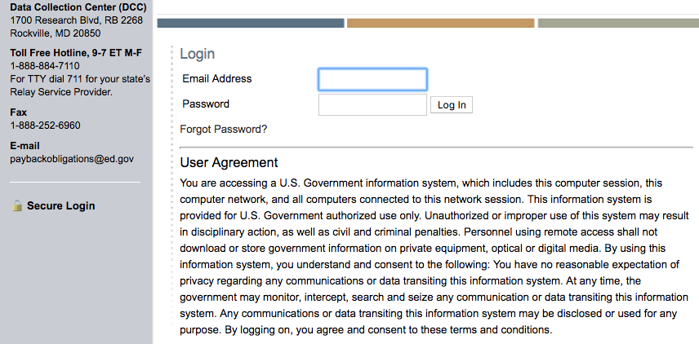
How do I reset my password?
Use the “Forgot Password” link on the login page.
Notes:
**Coming soon: Multi-Factor Authentication**

Slide 23

How often should I be logging into the PDPDCS?
Grantees must update information
in PDPDCS for all participants within
30 days of:
Enrolling a participant,
A change in status of a participant, or
The end of your grant’s fiscal year.
Notes:
As a reminder, grantees must update information in the PDPDCS for all participants within 30 days of enrolling a participant, any change in the participant’s status AND by the end of your grant’s fiscal year.

Slide 24

Why aren’t I (or my participants) receiving emails from the PDPDCS?
To ensure you and your participants receive all system notifications:
  Add paybackobligations@ed.gov to your contact list
  Check your email settings to be sure emails from this account are not marked as spam
  Enter a non-IHE email address for each participant

Slide 25
Why should I add a secondary user?
Project Directors are responsible for all data entries, however secondary users are permitted access to the PDPDCS.
Only two people per grant are permitted access.
Secondary users are given a unique login allowing the to enter participant information.
Secondary users also receive PDPDCS reminder emails and notifications.

Slide 26
Service Payback Agreement (SPA) Questions
 | SPA
When do participants and grantees sign the agreement? | To officially enroll in the grant-supported program, participants must sign and complete a SPA.
When do I upload the agreement? | Upload within 30 days of the participant’s enrollment.
Notes:
In the past we have found this chart as a helpful tool for you and your grant’s staff as a brief reminder of the requirements of the service payback agreement.
You must upload a redacted SPA within thirty days of a participant’s enrollment in the program. Since gathering the accurate information can take some time, we recommend starting that process as soon as possible.

Slide 27
Service Payback Agreement (SPA) Questions
What should I check prior to uploading? | Ensure you are using the correct version (OMB Control Number: 1810-0698 Expiration: 8/31/2022), All pages are included, All entries are written legibly, and the forms are signed by both the participant and grantee, and Social security numbers are redacted.
Notes:
When uploading the service payback agreements make sure that you are using the correct version, all pages have been included in the upload, all items are legible, and most importantly, the SSNs are redacted.

Slide 28
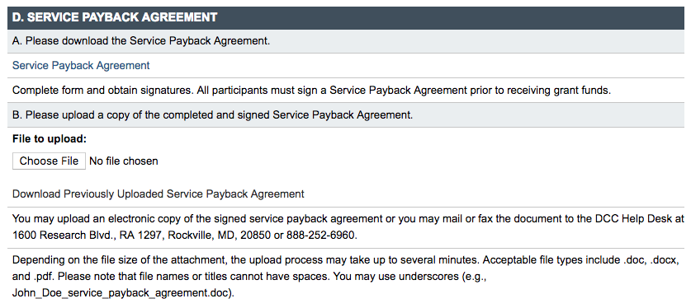
Service Payback Agreement Questions Continued
Grantees will not be able to submit participant records without uploading the service payback agreement.
Grantees should review to ensure the participant’s SSN is redacted.
Grantees may be responsible for repayment of grant funds in cases where they do not have a valid signed agreement for a participant.
Notes:
Participants’ names should match what’s in the DCS and SSNs should be redacted on the PSA and EC after you enter the SSN in the system.

Slide 29

What do I need to tell my participants about their payback obligation?
Clearly explain to your participants before they accept funding, that participants are required to:
Log into the PDPDCS and submit eligible employment information to receive credit towards their payback obligation
Update employment information annually
Participants may begin fulfilling their obligation through service once they have completed or exited the program
Notes:
In addition to the PSAs, you must disseminate to participants copies of the current regulations, 34 CFR part 263, and the frequently asked questions (FAQs). Participants also have certain requirements they must fulfill if they accept funding. Please explain clearly to your participants before they agree to accept funding their payback obligation requirements and continue to remind participants throughout the program about the requirements and that they will need to submit employment information.

Slide 30
What do I need to tell my participants about their payback obligation?
Participants who do not submit eligible employment information verified by their employer by the time their payback obligation must be fulfilled are not in compliance and will be referred to Accounts Receivable and Bank Management Division (ARBMD) for repayment.

Slide 31
My grant is ending this year. Is there anything I need to do in the PDPDCS?
Grantees must report all participants as “Exit Without Completion” or “Completed/Graduated” before their grant end date.

Slide 32

How Does OIE Use the Data that Grantees Report?
Grantee data is used to:
Support program performance measures
Track payback obligation requirements of participants,
Report to ARBMD for cash payback when participants do not comply with payback obligation regulations
Inform for internal reports, grant monitoring, and program improvement activities

Slide 33
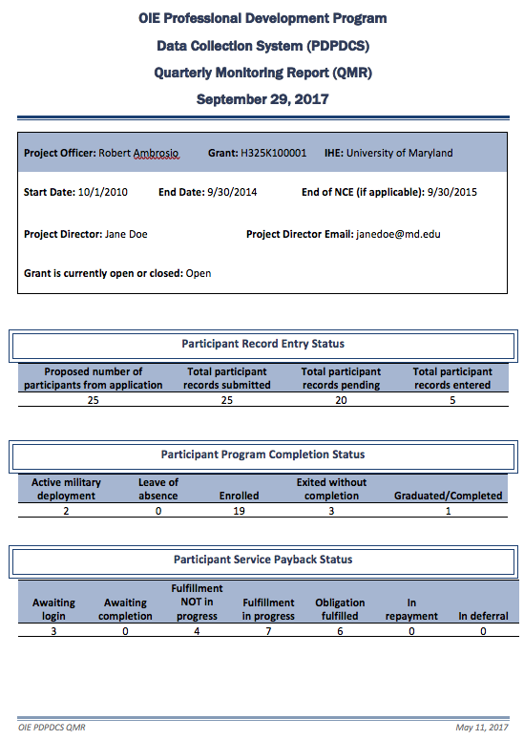
How Does OIE Use the Data that Grantees Report? (Continued)
Quarterly Monitoring Reports (QMR)
  Assists OIE Project Officers in monitoring the status of participants enrolled in each preparation program funded by OIE

Slide 34
What are some lessons learned from prior years?
  Use the OMB cleared service payback agreement form available on PDPDCS (or your agreement may not be valid)
  Ensure your participants are in “Submitted” status or they will be deleted.
  Ensure that the same number of participants you placed in “Submitted” status in PDPDCS is what you report in your APR.
  Ask your participants to log in to review the data you have entered.
Notes:
ANGELA

Slide 35

PD Grantee Deadlines
PDPDCS (https://pdp.ed.gov/oie)
Participant records submission deadline:
April 3, 2020
G5
(https://www.g5.gov)
APR submission deadline:
April 14, 2020
Notes:
ANGELA:
[Repeat deadlines for records vs. APR]

Slide 36
Resources and Support

Slide 37
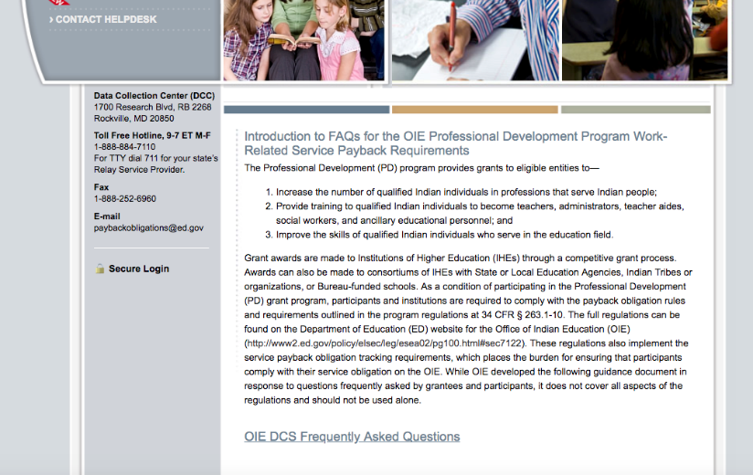
PDPDCS Resources
PDPDCS resources include:
An archived recording of this webinar will be made available (https://pdp.ed.gov/OIE/Home/Agreements)
PDPDCS Frequently
Asked Questions
(https://pdp.ed.gov/OIE/Home/faq/)
Notes:
A recording of this webinar will be made available on the website for grantees and staff who missed this training or need a refresher. In addition, on the website you can find responses to questions frequently asked by grantees, participants, and employers regarding program regulations and requirements pertaining to the grant funding, links to service payback regulations and service payback agreements. Our Help Desk is available M-F 8 am to 8pm EST via phone or email.

Slide 38
PDPDCS Resources
Payback obligation resources for grantees and participants:
Service Payback Agreements (https://pdp.ed.gov/OIE/Home/Regulation)
2015 Payback Obligation Regulations (https://pdp.ed.gov/OIE/Content/pdf/PD_Program_Regulations.pdf)
PDPDCS Frequently Asked Questions available at: (https://pdp.ed.gov/OIE/Content/pdf/OIE_DCS_FAQs.pdf)

Slide 39
Questions and Discussion
More questions?
PDPDCS Help Desk
  Support available from 8 am to 8 pm EST
  Monday through Friday
  1-888-884-7110
  For TTY dial 711 for your state’s Relay Service Provider
  paybackobligations@ed.gov

